Slide 1
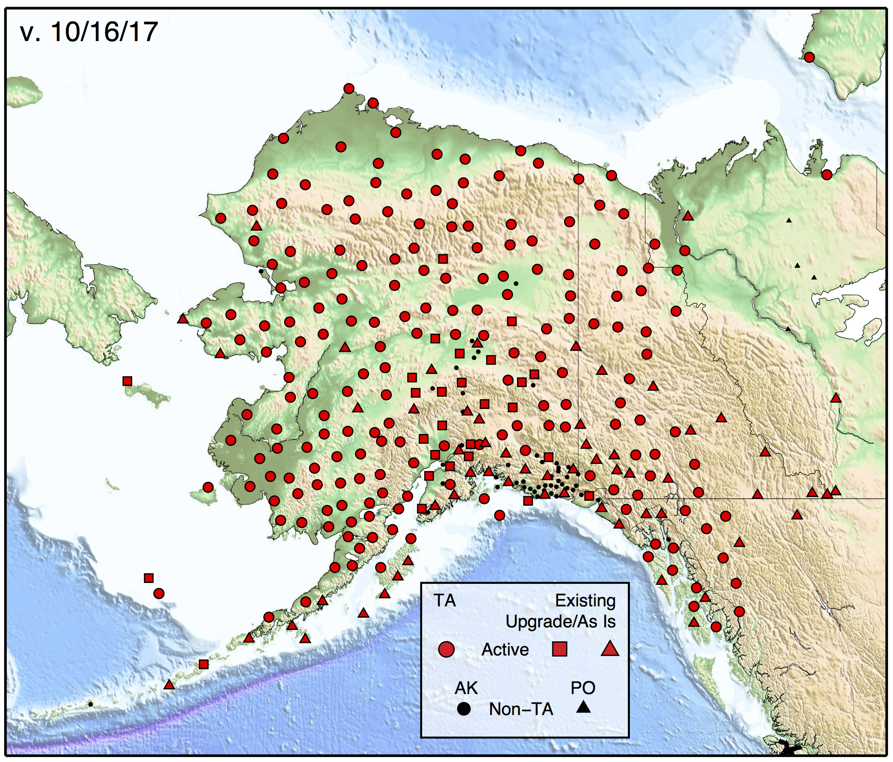
Seismic Sensors of the
Alaska Transportable Array
193 New TA Stations
28 TA Station Upgrades
59 Existing Stations
280 Total Stations

Slide 2
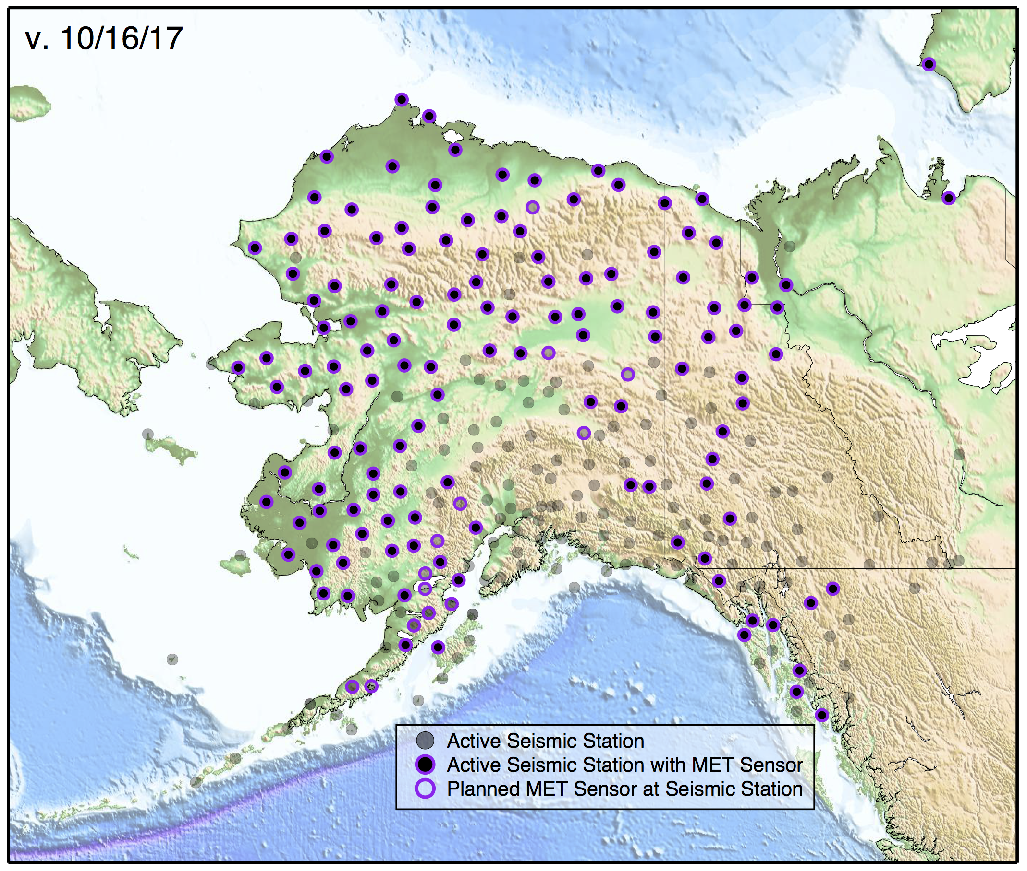
Meteorological Sensors of the
Alaska Transportable Array
132 Vaisala MET Sensors measuring:
Wind
Temperature
Humidity
Pressure
Precipitation Intensity
280 stations with infrasound and pressure sensors

Slide 3
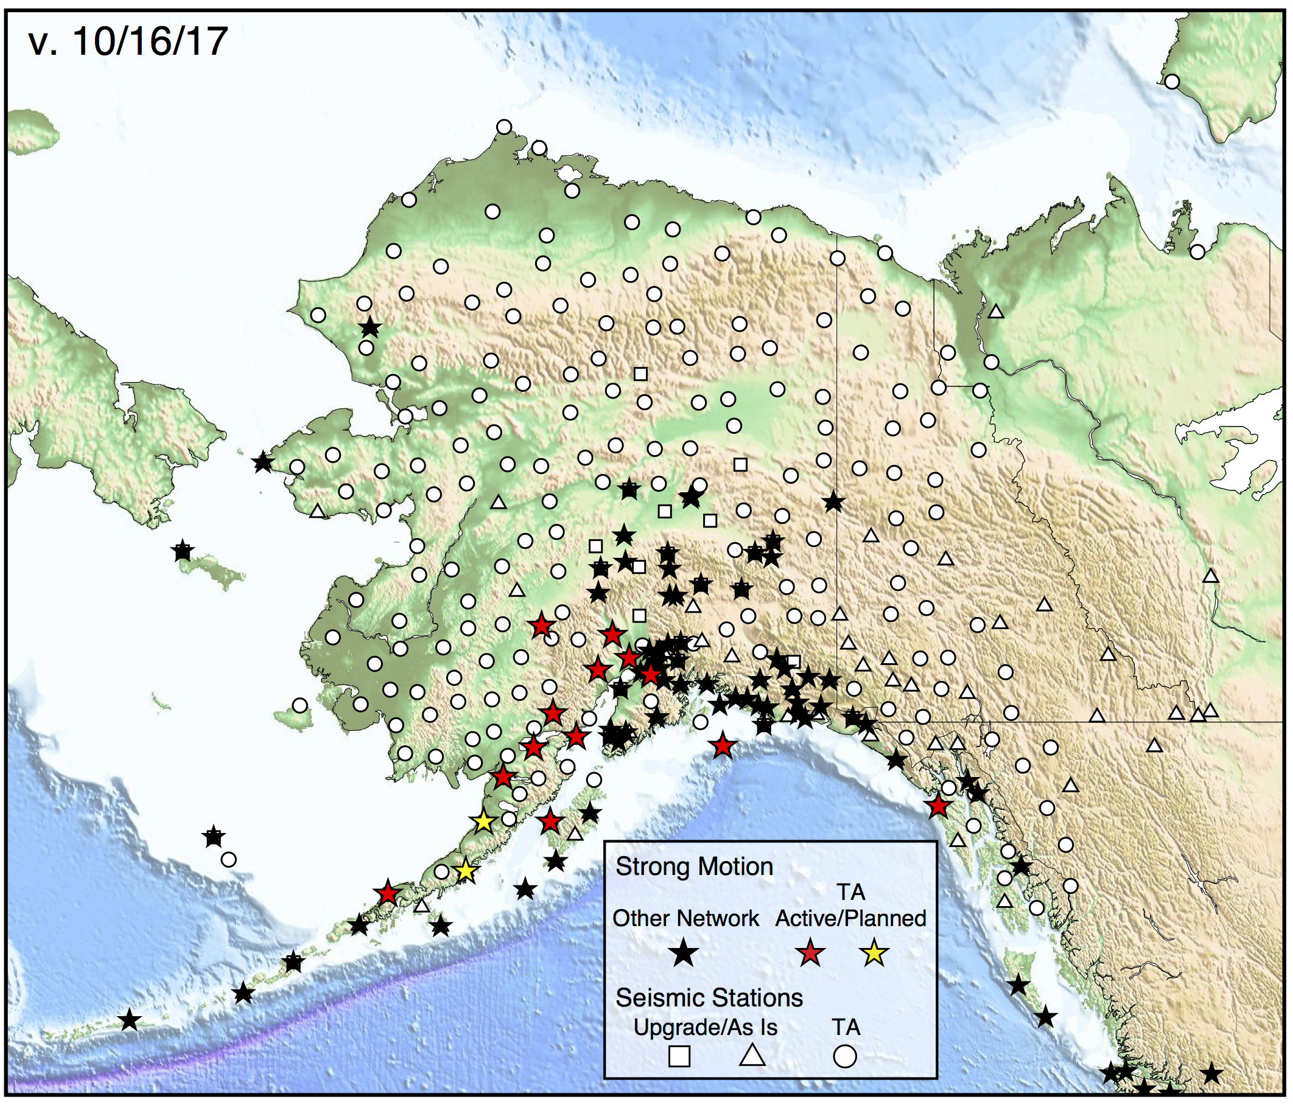
Strong Motion Sensors of the
Alaska Transportable Array
15 Strong Motion Sensors
New episensors installed at stations along the Aleutian subduction zone to complement the existing footprint

Slide 4
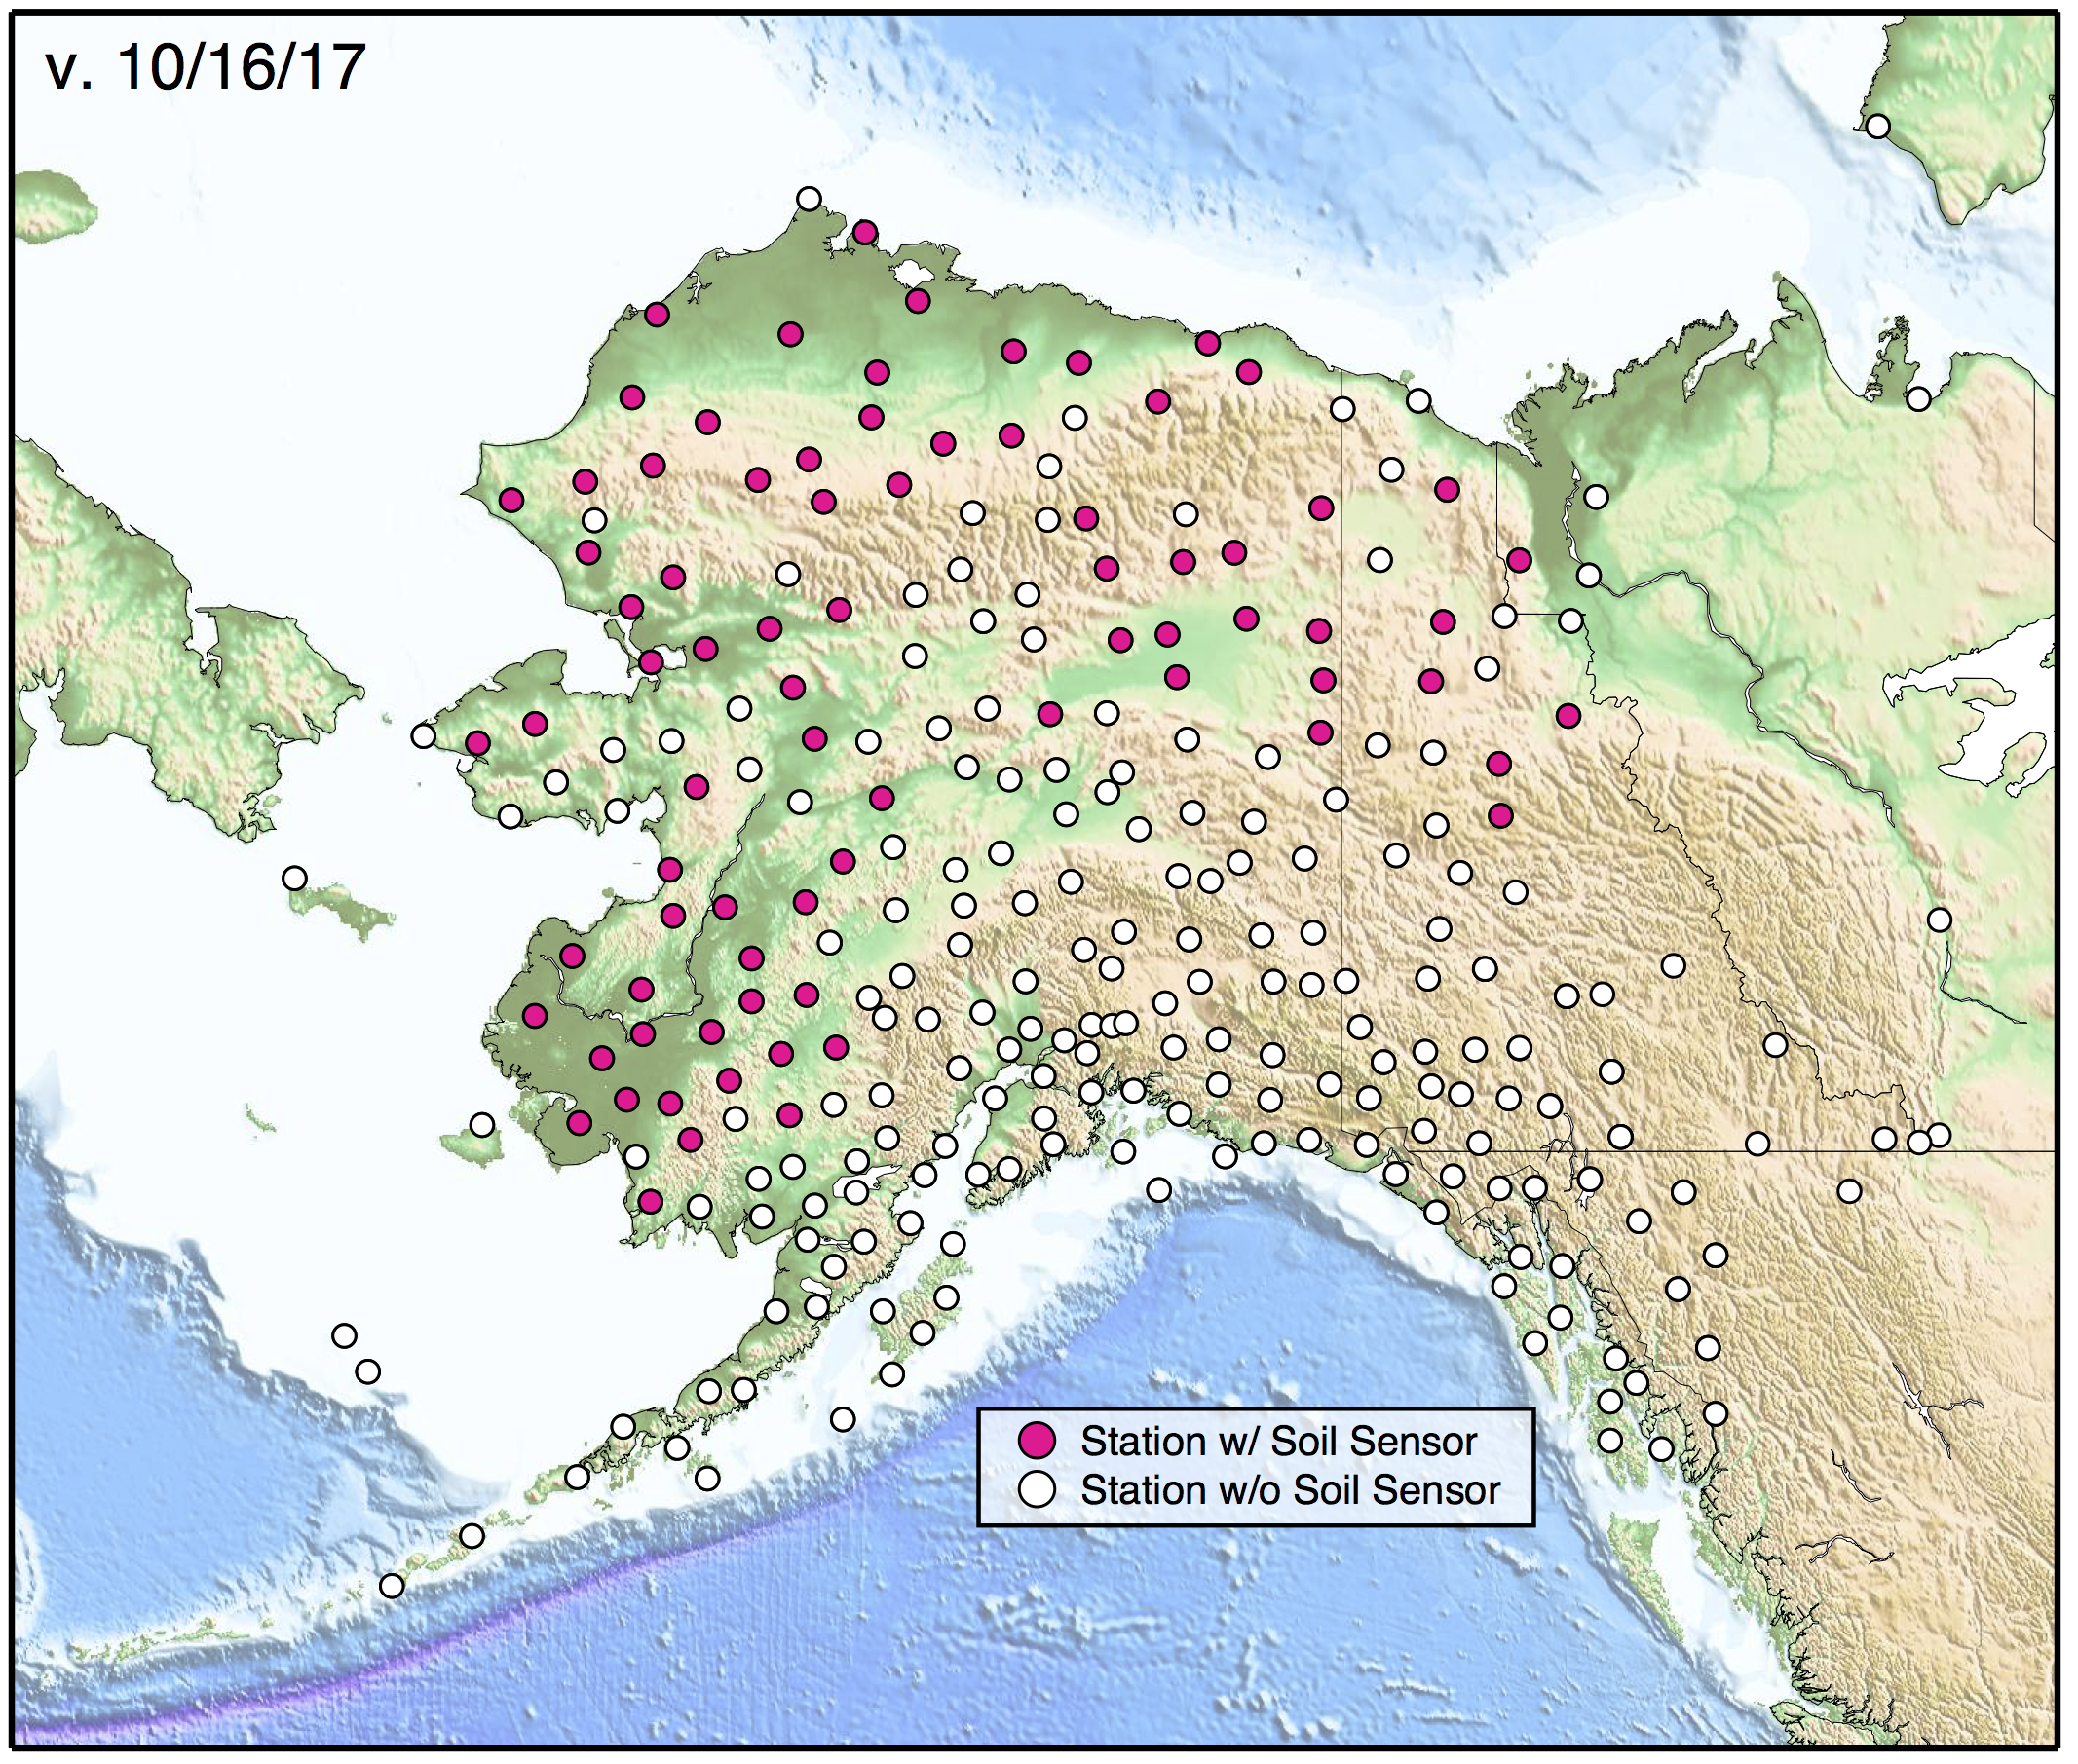
Soil Temperature Sensors of the
Alaska Transportable Array
78 Soil Temperature Sensors
Installed alongside TA stations, collecting data autonomously

